Slide 1
Weather Forecaster-Urban Heat Mitigation
KBN Skill Team

Slide 2
Welcome to our presentation!
This application, titled "Weather Forecaster," empowers users to effortlessly access detailed weather forecasts and visualize key weather data for any location. It leverages the OpenWeatherMap API and Python libraries to deliver an interactive and informative experience. Users can readily retrieve temperature, humidity, wind speed, rainfall, sunrise/sunset times, and a visual heat map for a chosen city.

Slide 3
Mitigation of urban heat
SEARCH

Slide 4
Contents
1
Introduction
4
Our Vision
2
About us
5
Technologies & System requirements
3
Proposed solutions
6
OUTPUT

Slide 5
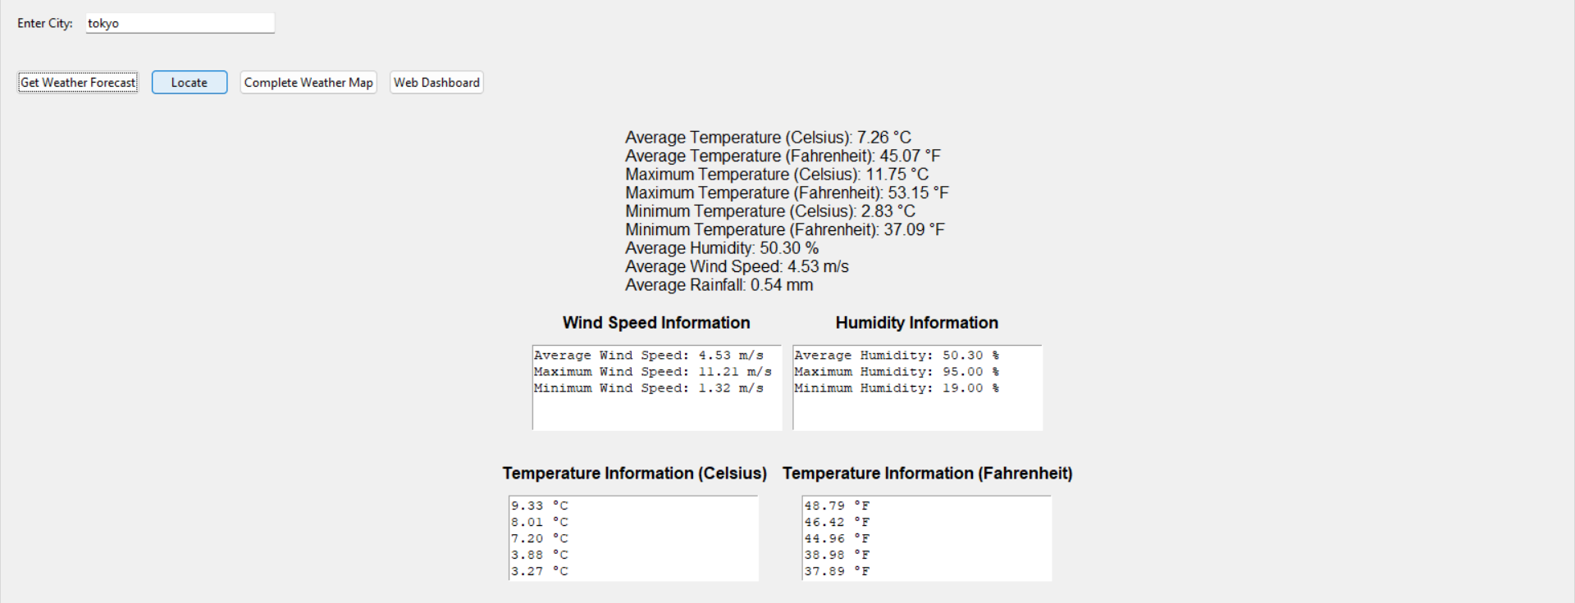
Introduction
Accurate and readily available weather information is crucial for individuals across various disciplines, from personal planning and outdoor activities to agricultural planning and disaster preparedness. However, relying solely on traditional methods like news reports or weather websites can be cumbersome and offer limited data visualization capabilities.

Slide 6

GEETA GAYATHRI
Designer
Geeta Gayathri, a skilled Python web developer with a flair for design and organization. Enthusiastic about coding, I bring creativity and innovation to projects.

Slide 7

NAVED ABBAS
System tester
Hello, everyone!
Let me introduce myself a bit.
Naved Abbas, adapt in system testing with a talent for generating creative ideas and strong verbal communication skills.

Slide 8

K.DOONDI
Code Developer
Hello, everyone!
Let me introduce myself a bit.
I'm K.DOONDI, a passionate coder fluent in Java & Python. I'm driven to solve real-world issues through innovative projects, aiming to be recognized as a top coder.

Slide 9
Let’s begin now!
This project tackles the challenge of providing users with a convenient and interactive platform for accessing comprehensive weather forecasts and visualizing relevant data. Traditional methods often lack comprehensiveness, user-friendliness, or the ability to present data visually.

Slide 10
Research Problem
Urban heat refers to a phenomenon called the Urban Heat Island (UHI) effect. It describes how cities become significantly warmer than surrounding rural areas. Here's a breakdown of what causes it:
Material Matters: Cities are full of concrete, asphalt, and metal surfaces which absorb and trap heat from the sun much more effectively than natural landscapes like soil and vegetation. These materials also release the heat back into the surrounding air long after sunset, making nights warmer in cities.
City Hustle, City Heat: All the activity in a city - from cars and buses to air conditioners and people - generates waste heat. This heat adds to the overall warmth of the urban environment.
The temperature difference between a city and its surroundings can be several degrees Fahrenheit, but it can have a big impact. Here are some of the consequences of urban heat:
Health Risks: Extreme heat can lead to heatstroke, heat exhaustion, and other health problems, especially for vulnerable populations like children and the elderly.
Air Quality Woes: Hotter air can trap pollutants closer to the ground, worsening air quality and causing respiratory problems.
Energy Drain: People in cities use more air conditioning during heat waves, which can put a strain on the power grid.
There are ways to mitigate urban heat, such as planting more trees, using lighter-colored reflective surfaces for pavements and roofs, and creating urban green spaces.

Slide 11
Proposed Solution
"Weather Forecaster" addresses these limitations by offering:”
Centralized access: Easily retrieve forecasts for any location.
Comprehensive data: View temperature, humidity, wind speed, rainfall, and sunrise/sunset times.
Interactive visualization: Gain insights through a heat map.
User-friendly interface: Interact with the application effortlessly.
Technologies Used:
Python: The versatile programming language provides the foundation for building the application.
Tkinter: This Python library constructs the user-friendly graphical user interface (GUI).
OpenWeatherMap API: This API supplies the crucial weather data for the application.
Matplotlib: This library creates informative visualizations of the retrieved data.
Pytz: This Python library handles time zones, ensuring accurate time displays in various locations.

Slide 12

Our vision
This application, titled "Weather Forecaster," empowers users to effortlessly access detailed weather forecasts and visualize key weather data for any location. It leverages the OpenWeatherMap API and Python libraries to deliver an interactive and informative experience. Users can readily retrieve temperature, humidity, wind speed, rainfall, sunrise/sunset times, and a visual heat map for a chosen city.

Slide 13

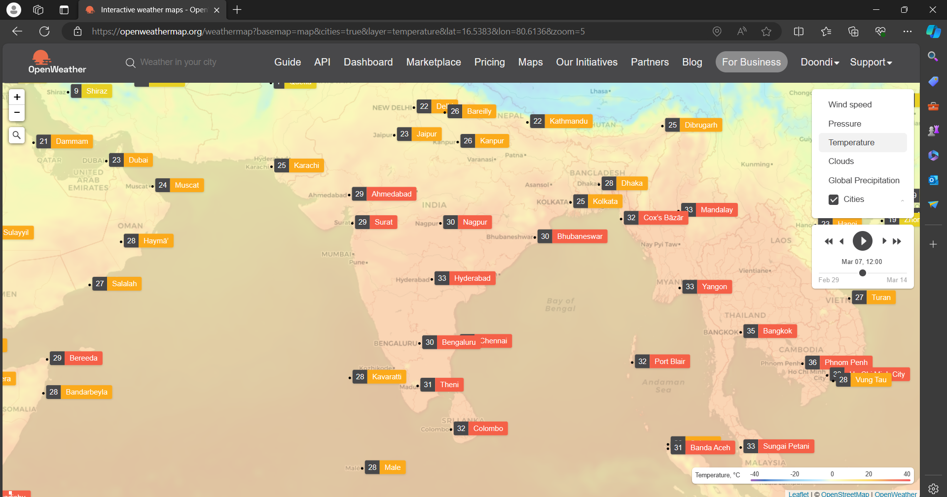
Technologies Used:
Python: The versatile programming language provides the foundation for building the application.
Tkinter: This Python library constructs the user-friendly graphical user interface (GUI).
OpenWeatherMap API: This API supplies the crucial weather data for the application.
Matplotlib: This library creates informative visualizations of the retrieved data.
Pytz: This Python library handles time zones, ensuring accurate time displays in various locations.

Slide 14

System Requirements:
Operating system: Windows, macOS, or Linux
Python: Version 3.x or later (check using python --version in your terminal)
Required libraries:
requests
matplotlib
folium
h3 & build c++ tools
timezonefinder
geopy
pytz
tkinter (often included in Python installations)
OpenWeatherMap API key: Obtain one from https://openweathermap.org/api

Slide 15
Modules:
Data Acquisition Module:
Manages API interaction to fetch weather data for the specified location.
Error handling for potential API issues.
Data Processing Module:
Transforms and prepares the retrieved data for visualization.
Calculates averages and other statistics.
Visualization Module:
Employs Matplotlib to create informative plots and heat maps.
Presents temperature, humidity, wind speed, and rainfall data visually.
GUI Module:
Uses Tkinter to construct a user-friendly interface.
Consists of entry fields, buttons, and display areas.

Slide 16
OUTPUT

Slide 17
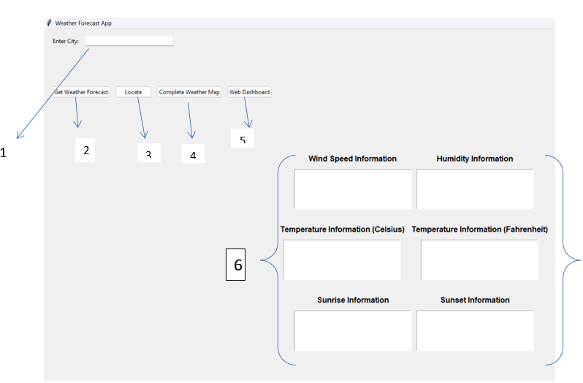
City Input Field: A text box where you can enter the name of a city to retrieve weather information for that location.
Get Weather Forecast Button: A button that initiates the process of fetching weather data from an external source (likely an API) based on the city name you entered.
Locate : Displays the Current Location of the input place
Complete Weather Map: This will redirect to the Open Weather map of Locations
Web Dashboard: This component is intended for the web version of this app developed using the no-code development strategies with a merge of Google API
Weather Statistics Labels: These labels display various weather statistics and details once you’ve retrieved the forecast for a city.
.

Slide 18
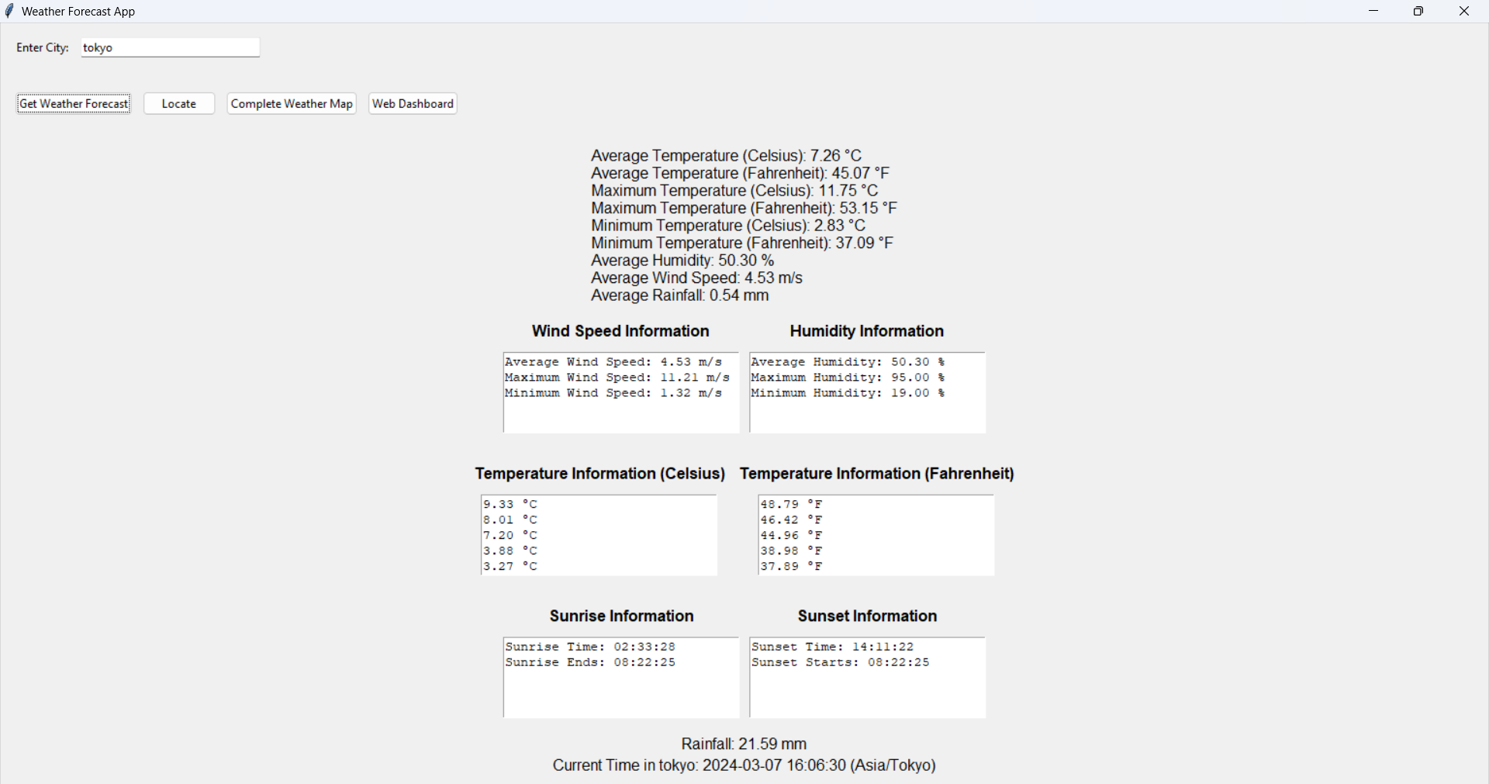
Temperature: Current temperature, average temperature, minimum and maximum temperatures (often shown in both Celsius and Fahrenheit).
Humidity: Average or current humidity percentage.
Wind Speed: Average or current wind speed and direction.
Sunrise/Sunset Times: Exact times for sunrise and sunset, potentially including twilight periods.
Rainfall (if available): Total rainfall amount for the forecast period.
Current Time in the City: Time displayed based on the retrieved weather data and the city's time zone.
.

Slide 19
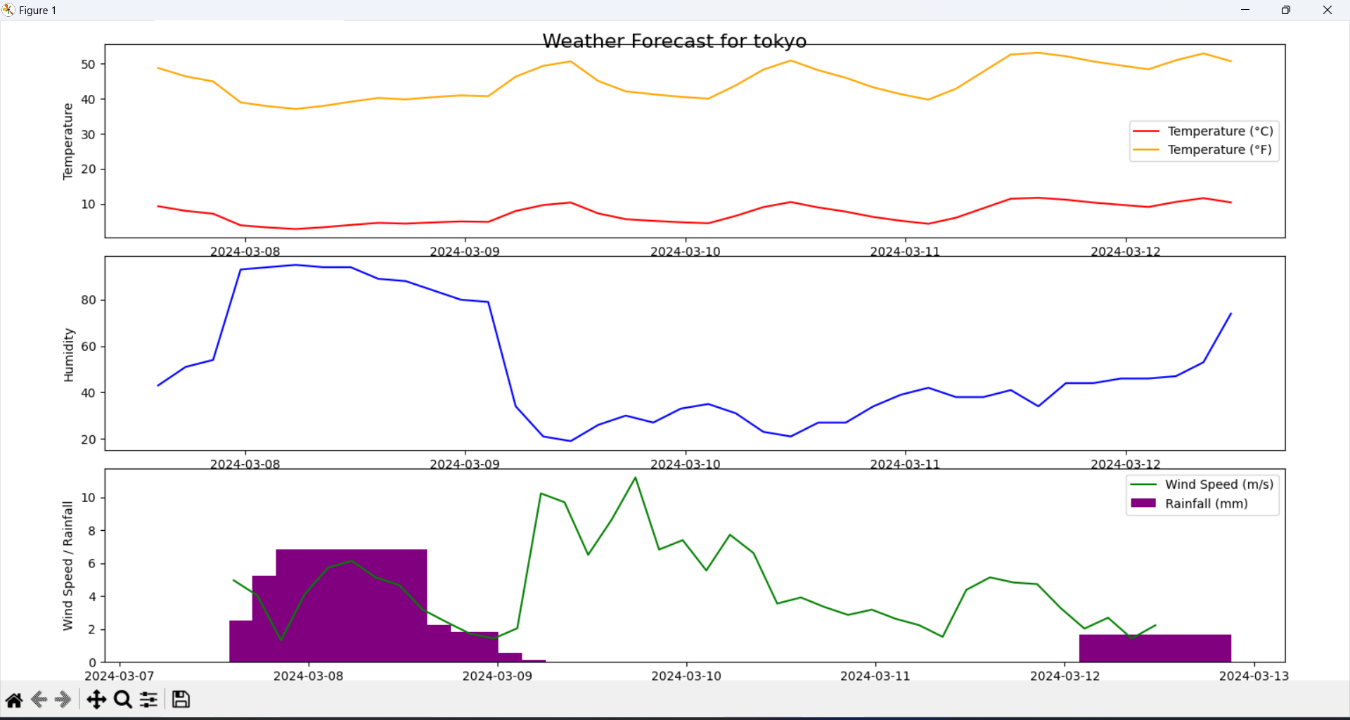
Temperature: Current temperature, average temperature, minimum and maximum temperatures (often shown in both Celsius and Fahrenheit).
Humidity: Average or current humidity percentage.
Wind Speed: Average or current wind speed and direction.
Rainfall (if available): Total rainfall amount for the forecast period.
.

Slide 20
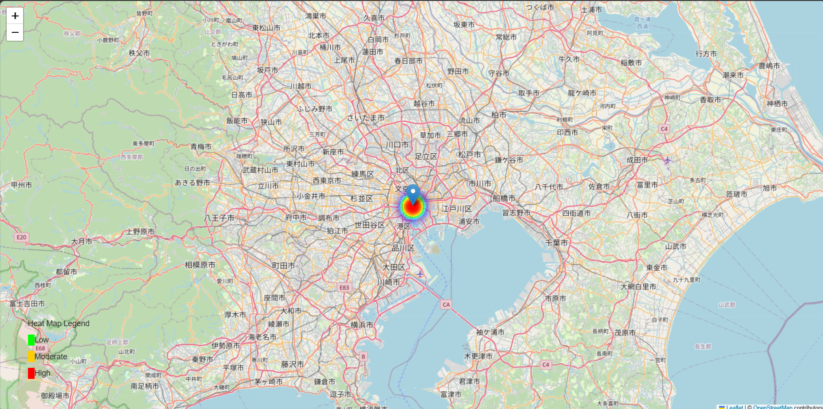
LOCATE:
This locate button is use to show location of city.
GREEN: It is use to show the LOW-TEMPERATURE
YELLOW: It is use to show the MODERATE-TEMPERATURE
RED: It is use to show the HIGH-TEMPERATURE
.

Slide 21
COMPLETE WEATHER MAP:
If the application allows heat map visualization, this button would trigger a heat map creation process for the entered city. The provided code offers limited heat map functionality, so results might not be extensive.
.

Slide 22
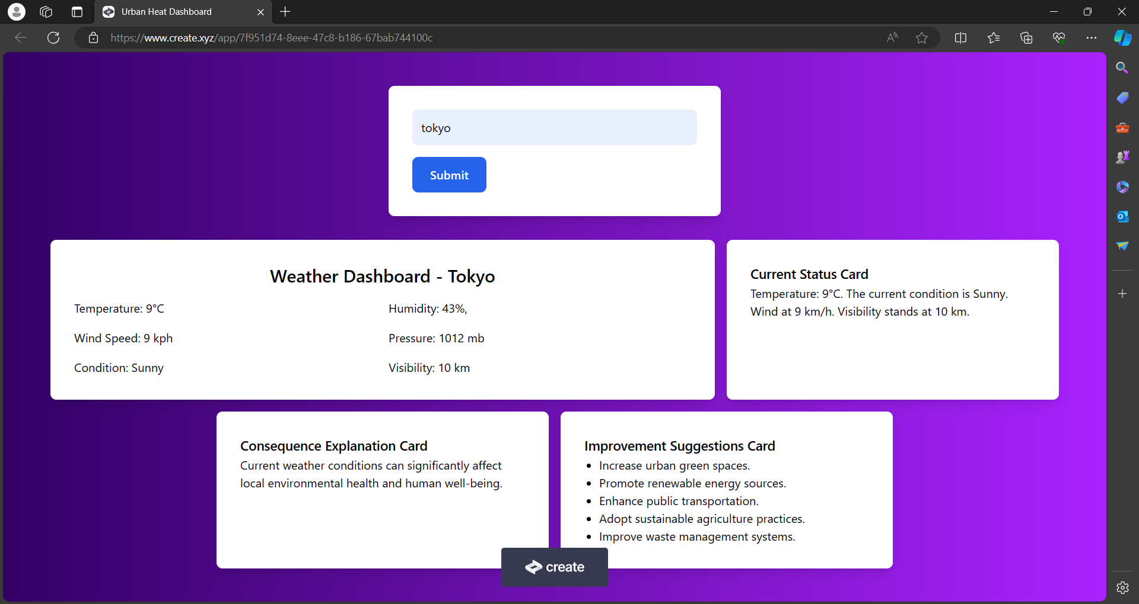
WEB DASHBOARD:
This website in your web browser, such as a website dedicated to urban heat maps (the code you provided included functionality to open a specific website).

Slide 23
Conclusion:
"Weather Forecaster" effectively addresses the need for a user-centric, comprehensive, and visually appealing weather information platform. Its strengths lie in its ease of use, rich data presentation, and flexibility for diverse use cases. By leveraging the OpenWeatherMap API and various Python libraries, this application empowers users with tailored weather insights within their fingertips.
.
NOTE:
Ensure you have an internet connection for the application to function properly.
The specific layout and elements of the GUI window might vary slightly depending on the application you're using.
While the provided code offers heat map functionality, it's currently limited. Explore the application itself to see what heat map options are available.

Slide 24
Thank you for watching!

